Slide 1
Srinivas Rao PrithviNag Kolla
INFO 5709 Fall 2020
Final Project

Slide 2
US ELECTION ANALYSIS
Recently, US 2020 Elections were held, and the main contestants were Joe Biden from Democratic party and Donald Trump from Republican Party. I wanted to do an analysis on Twitter data to get results of who will be the possible winner of US 2020 Elections.

Slide 3
Introduction
In this analysis, I have used Zomato Restaurant Data Set.
Here are some Goals that I wanted to find in the analysis:
How many Zomato restaurants are there in each country?
Finding out count of Zomato restaurants in each Country with specific ratings?
Which Restaurant provides Indian Cuisine?
What are the restaurants that are present near to me with 5-star rating?
Which restaurant provides online delivery options near me with 5-star rating and minimum average cost per two?
Which city has best Chinese cuisine in India?
Check whether Barbeque nation has Table booking option or not?
To check if a restaurant has multiple branches in other countries?
Check the popularity of each restaurant branches in all countries or states?
What are the restaurants near me with table booking, online delivery options, order menu, having reasonable cost and having highest rating?
How many restaurants have less than 1 year of age?
Which restaurant is the oldest, if there are more than two, then how many restaurants provide reasonable price too with more rating?

Slide 4
Data Set
Zomato Restaurant Data Set was collected by Shruthi Mehta in the year 2017.
There is a total of 9551 Records and 22 columns in the Zomato Restaurant Data Set.
Number of Data Types that are present are:
1. float = 3
2. Integer = 5
3. object = 14
Data Source : https://www.kaggle.com/shrutimehta/zomato-restaurants-data

Slide 5
Data Dictionary
Column Description
1. Restaurant ID Identification Number
2. Restaurant Name Name Of the Restaurant
3. Country Code Country Code
4. City City Name of the Restaurant
5. Address Address
6. Locality Shot Address Of the Restaurant
7. Locality Verbose Long Address of the Restaurant
8. Longitude Longitude
9. Latitude Latitude
10. Cuisines Types Of Cuisines Served
11. Average Cost for two. Average Cost if two people visit the Restaurant
12. Currency Dollars
13. Has Table booking Can we book tables in Restaurant? Yes/No
14. Has Online delivery Can we have online delivery ? Yes/No
Is delivering now Is the Restaurant delivering food now? Yes/No
15. Switch to order menu Switch to order menu ? Yes/ No
16. Price range Categorized price between 1 -4
17. Aggregate rating Categorizing ratings between 1-5
18. Rating color Different colors representing Customer Rating
19. Rating text Different Rating like Excellent, Very Good ,Good, Avg., Poor, Not Rated
20. Votes No: Of Votes received by restaurant from customers.
21. Country Country Name
22. Date Date

Slide 6

Data Cleaning
In Zomato Restaurant Data, Cuisines has blanks and Averages, Aggregate Rating has 0 as value in some records and that should be cleared . Since they are few, we remove them by using Filter Tool.
Since there is only Country Code given, we need to create a Country Name Column.
There is also the average cost per two column but in different currencies, hence create a column of one common currency. Here I wanted to work on Dollars as I am presently working for USA Project.
Since there is no Date column, I added a Date column using Date() function for finding out how old the restaurants are.
We cannot find the rating when it is in text, I converted the Rating column which was in text into numbers as it would be easy to make visualizations.

Slide 7
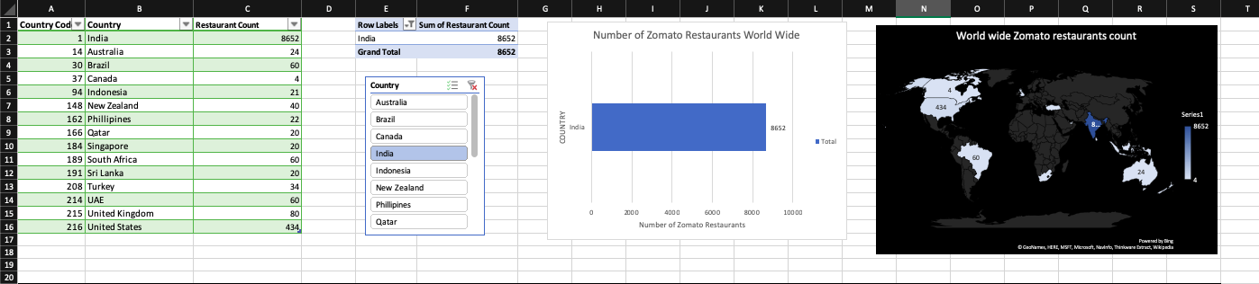
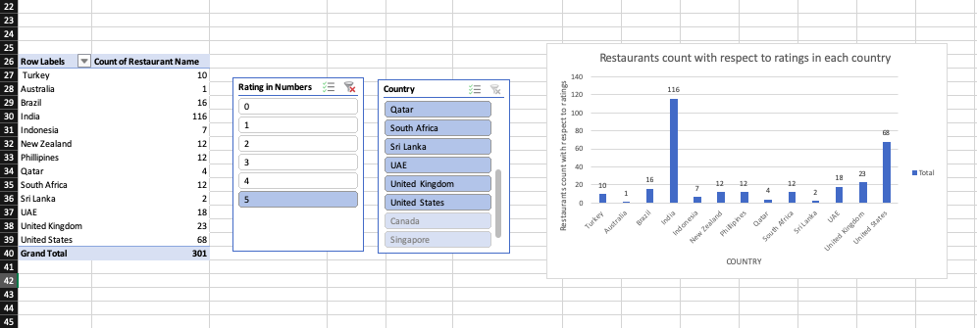
Data Analysis
Here I found Count of Zomato Restaurants that were present in each country after Data Cleaning. There were 9551 Restaurants out of which Maximum of 8652 restaurants were present only in “India” and Minimum of 4 Restaurants were present in Canada. I have used slicers and 3D map for better understanding of Pivot table and Pivot chart.

Slide 8
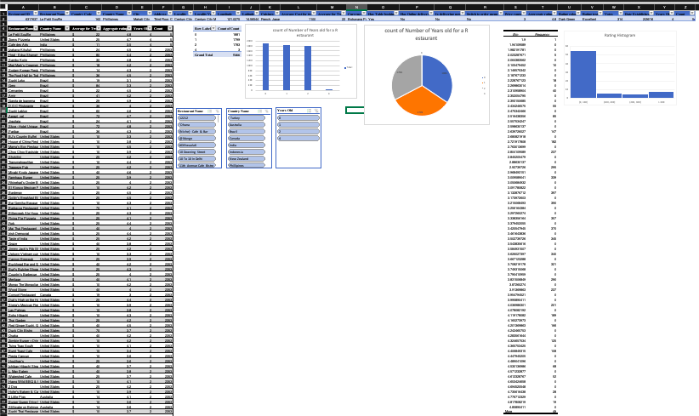
Data Analysis
Here I wanted to find highest rated Zomato restaurants count in each country , and I found that India is leading the chart board with 116 restaurants having 5 star rating, which gives 1.34% of the total restaurants in India that is 8652 restaurants are best.

Slide 9
Data Analysis
The Pivot chart shows number of restaurants that are grouped into their respective ages. For example: there are 1881 restaurants in the cleaned data that are less than 1 year of age group.
The pie chart shows the similar count of the number of restaurants that are grouped into their respective ages. For example: there are 3 Restaurants in the Cleaned data that are above 4 years of age.
Descriptive Statistics Results:
With the help of Data Analysis ToolPak tool I was able to create a Histogram values like Bins and Frequency of the ratings occurring for the Ratings column given for the restaurants
The Table of values were helpful in creating the Histogram.

Slide 10
Conclusion
Found Maximum restaurant share in each country.
Here I found out an interesting factor that even though India shares the maximum number of restaurants . It has very few 5 star hotels about 1% .
Here I found out the oldest restaurant with highest rating and lowest average cost per two .
Here I found out the frequency distribution of ratings.

Slide 11
References
[Leila Gharani]. (Feb 1, 2018). Excel IF Formula: Simple to Advanced (multiple criteria, nested IF, AND, OR functions). Retrieved from https://youtu.be/KkTaQ5OjAGc
[HNU Paul J. Cushing Library]. (Oct 4, 2016) APA How to create a running head in Word for Mac. Retrieved from https://youtu.be/WtOr53z1bUg
delete row from Excel where column cell is empty. (2019).Retrieved from https://superuser.com/questions/288908/delete-row-from-excel-where-column-cell-is-empty
[Excel, Word and PowerPoint Tutorials from Howtech]. (Aug 8, 2013) How to Use the HLOOKUP Function in Excel. Retrieved from https://www.youtube.com/watch?v=iiu-GtBkAuk
[Microsoft]. Create a pivot chart. Referenced From: https://support.office.com/en-us/article/create-a-pivotchart-c1b1e057-6990-4c38-b52b-8255538e7b1c
[Thierry Tremblay]. (February 14, 2019). What is a Pivot Table?. Referenced From: https://www.kohezion.com/blog/what-is-a-pivot-table-examples-and-uses/
[MJ Tube].MS Excel: How to Convert Days & Dates into Years Months & Days. Referenced from: https://www.youtube.com/watch?v=LuhiyQPPKHQ

Slide 12
Thank You

